Slide 1

Section 5.3: Sensitivity Analysis
MTH 564 – Mathematical Modeling

Slide 2

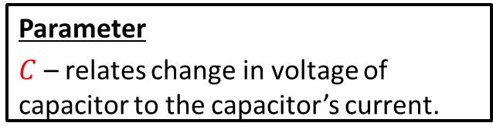
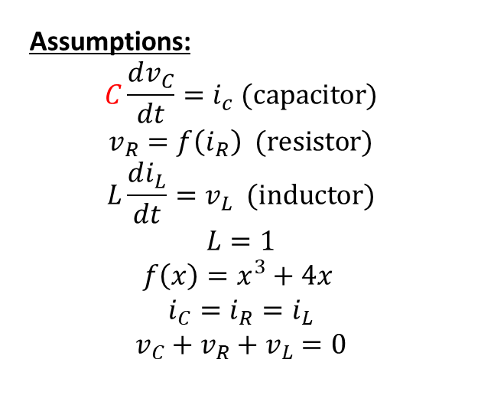
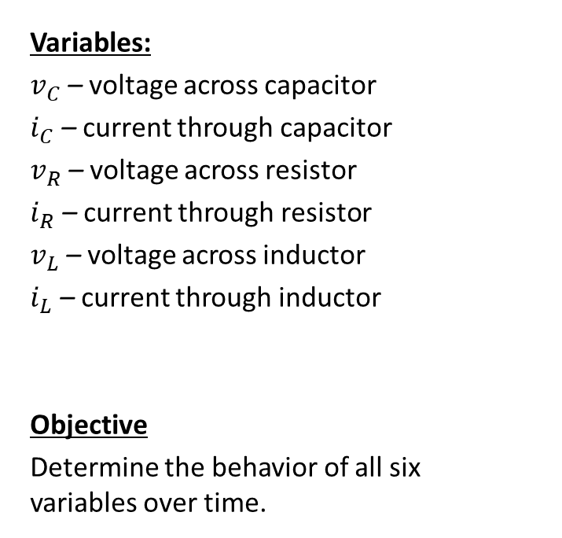
Sensitivity Analysis on C
Variables:
$v_{C}$ – voltage across capacitor
$i_{C}$ – current through capacitor
$v_{R}$ – voltage across resistor
$i_{R}$ – current through resistor
$v_{L}$ – voltage across inductor
$i_{L}$ – current through inductor
Objective
Determine the behavior of all six variables over time.
Assumptions:
$$C\frac{dv_{C}}{dt}=i_{c} (capacitor)$$
$$v_{R}=f\left(i_{R}\right) (resistor)$$
$$L\frac{di_{L}}{dt}=v_{L} (inductor)$$
$$L=1$$
$$f\left(x\right)=x^{3}+4x$$
$$i_{C}=i_{R}=i_{L}$$
$$v_{C}+v_{R}+v_{L}=0$$
Parameter
$C$ – relates change in voltage of capacitor to the capacitor’s current.

Slide 3
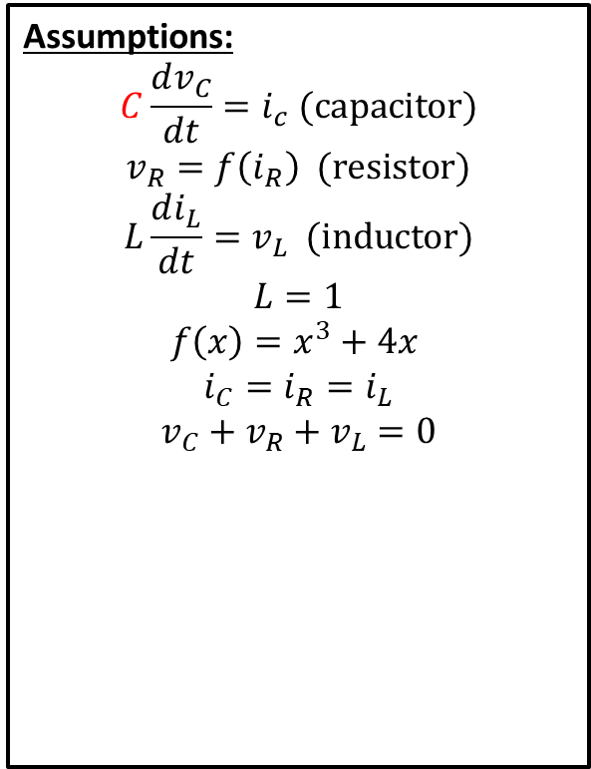
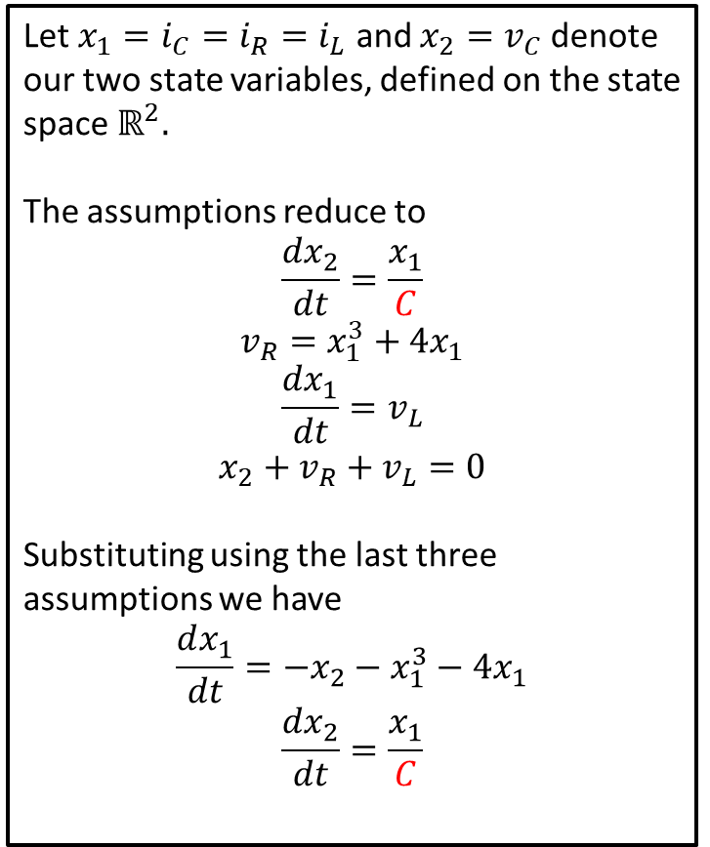
Changes to Model
Assumptions:
$$C\frac{dv_{C}}{dt}=i_{c} (capacitor)$$
$$v_{R}=f\left(i_{R}\right) (resistor)$$
$$L\frac{di_{L}}{dt}=v_{L} (inductor)$$
$$L=1$$
$$f\left(x\right)=x^{3}+4x$$
$$i_{C}=i_{R}=i_{L}$$
$$v_{C}+v_{R}+v_{L}=0$$
Let $x_{1}=i_{C}=i_{R}=i_{L}$ and $x_{2}=v_{C}$ denote our two state variables, defined on the state space $ℝ^{2}.$
The assumptions reduce to
$$\frac{dx_{2}}{dt}=\frac{x_{1}}{C}$$
$$v_{R}=x_{1}^{3}+4x_{1}$$
$$\frac{dx_{1}}{dt}=v_{L}$$
$$x_{2}+v_{R}+v_{L}=0$$
Substituting using the last three assumptions we have
$$\frac{dx_{1}}{dt}=−x_{2}−x_{1}^{3}−4x_{1}$$
$$\frac{dx_{2}}{dt}=\frac{x_{1}}{C}$$

Slide 4
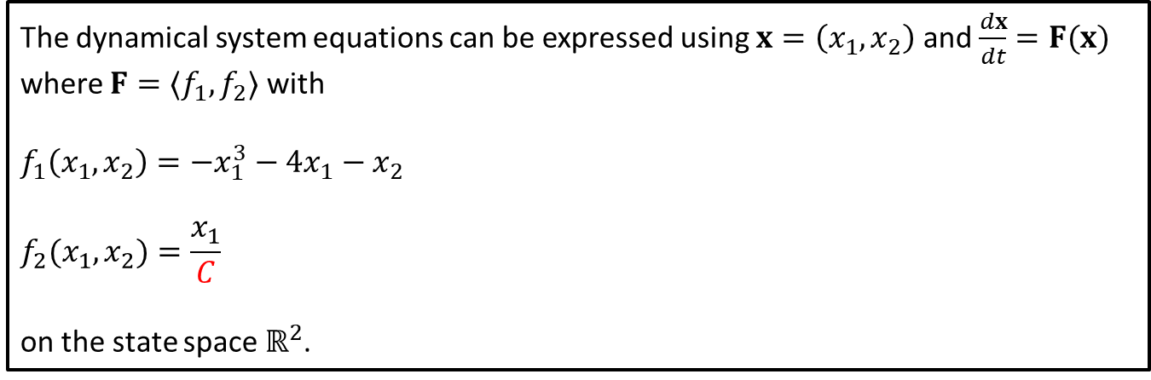

Changes to Formulation of Model
We are left with the dynamical system
$$\frac{dx_{1}}{dt}=−x_{2}−x_{1}^{3}−4x_{1}$$
$$\frac{dx_{2}}{dt}=\frac{x_{1}}{C}$$
The dynamical system equations can be expressed using $x=\left(x_{1},x_{2}\right)$ and $\frac{dx}{dt}=F(x)$ where $F=〈f_{1},f_{2}〉$ with
$$f_{1}\left(x_{1},x_{2}\right)=−x_{1}^{3}−4x_{1}−x_{2}$$
$$f_{2}(x_{1},x_{2})=\frac{x_{1}}{C}$$
on the state space $ℝ^{2}$.

Slide 5
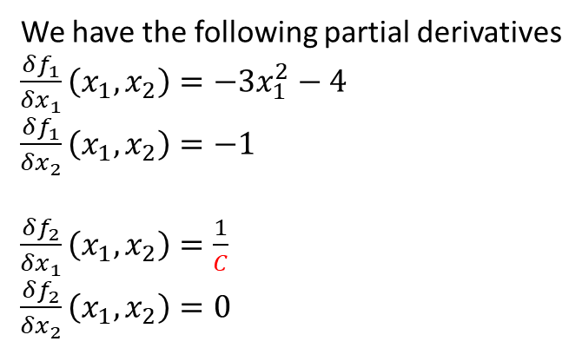
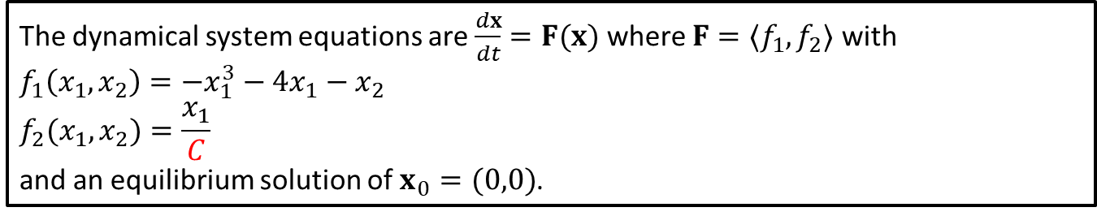
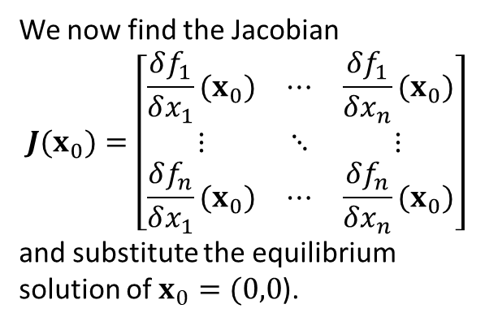
Solutions
The dynamical system equations are $\frac{dx}{dt}=F(x)$ where $F=〈f_{1},f_{2}〉$ with
$$f_{1}\left(x_{1},x_{2}\right)=−x_{1}^{3}−4x_{1}−x_{2}$$
$$f_{2}(x_{1},x_{2})=\frac{x_{1}}{C}$$
and an equilibrium solution of $x_{0}=(0,0)$.
We now find the Jacobian
$$J(x_{0})=\left[\begin{matrix}\frac{δf_{1}}{δx_{1}}(x_{0}) & ⋯ & \frac{δf_{1}}{δx_{n}}(x_{0}) \\ ⋮ & ⋱ & ⋮ \\ \frac{δf_{n}}{δx_{1}}(x_{0}) & ⋯ & \frac{δf_{n}}{δx_{n}}(x_{0})\end{matrix}\right]$$
and substitute the equilibrium solution of $x_{0}=(0,0$).
We have the following partial derivatives
$\frac{δf_{1}}{δx_{1}}\left(x_{1}, x_{2}\right)=−3x_{1}^{2}−4$
$\frac{δf_{1}}{δx_{2}}\left(x_{1}, x_{2}\right)=−1$
$\frac{δf_{2}}{δx_{1}}\left(x_{1}, x_{2}\right)=\frac{1}{C}$
$\frac{δf_{2}}{δx_{2}}\left(x_{1}, x_{2}\right)=0$
Notes:
See python file section1-1pig.py

Slide 6
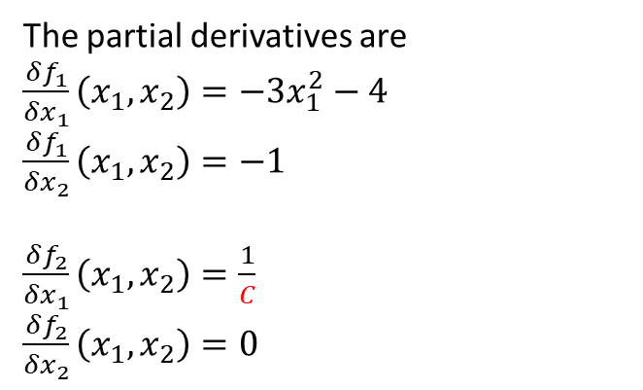
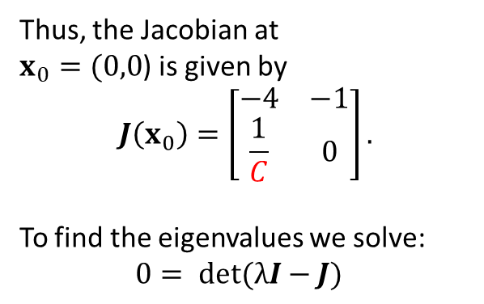
Jacobian
The dynamical system equations are $\frac{dx}{dt}=F(x)$ where $F=〈f_{1},f_{2}〉$ with
$$f_{1}\left(x_{1},x_{2}\right)=−x_{1}^{3}−4x_{1}−x_{2}$$
$$f_{2}(x_{1},x_{2})=\frac{x_{1}}{C}$$
and an equilibrium solution of $x_{0}=(0,0)$.
The partial derivatives are
$\frac{δf_{1}}{δx_{1}}\left(x_{1}, x_{2}\right)=−3x_{1}^{2}−4$
$\frac{δf_{1}}{δx_{2}}\left(x_{1}, x_{2}\right)=−1$
$\frac{δf_{2}}{δx_{1}}\left(x_{1}, x_{2}\right)=\frac{1}{C}$
$\frac{δf_{2}}{δx_{2}}\left(x_{1}, x_{2}\right)=0$
Thus, the Jacobian at $x_{0}=(0,0$) is given by
$$J\left(x_{0}\right)=\left[\begin{matrix}−4 & −1 \\ \frac{1}{C} & 0\end{matrix}\right].$$
To find the eigenvalues we solve:
$$0= det(λI−J)$$
Notes:
See python file section1-1pig.py

Slide 7
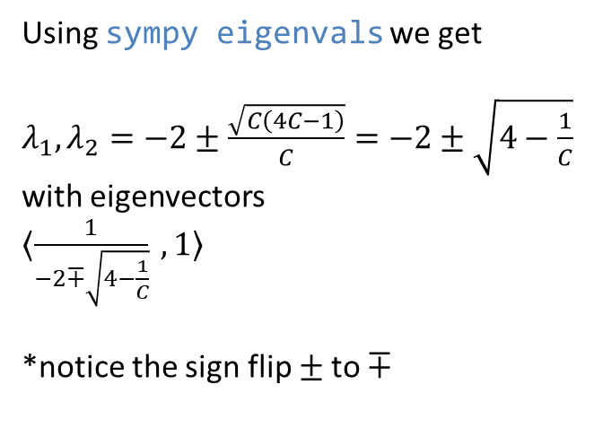
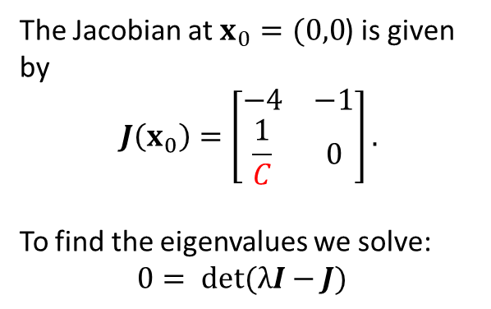
Eigenvalues and Eigenvectors
The dynamical system equations are $\frac{dx}{dt}=F(x)$ where $F=〈f_{1},f_{2}〉$ with
$$f_{1}\left(x_{1},x_{2}\right)=−x_{1}^{3}−4x_{1}−x_{2}$$
$$f_{2}(x_{1},x_{2})=\frac{x_{1}}{C}$$
and an equilibrium solution of $x_{0}=(0,0)$.
The Jacobian at $x_{0}=(0,0$) is given by
$$J\left(x_{0}\right)=\left[\begin{matrix}−4 & −1 \\ \frac{1}{C} & 0\end{matrix}\right].$$
To find the eigenvalues we solve:
$$0= det(λI−J)$$
Using sympy eigenvals we get
$λ_{1},λ_{2}=−2±\frac{\sqrt{C\left(4C−1\right)}}{C}=−2±\sqrt{4−\frac{1}{C}}$ with eigenvectors $〈\frac{1}{−2∓\sqrt{4−\frac{1}{C}}} ,1〉$
*notice the sign flip $±$to $∓$
Notes:
See python file section1-1pig.py

Slide 8
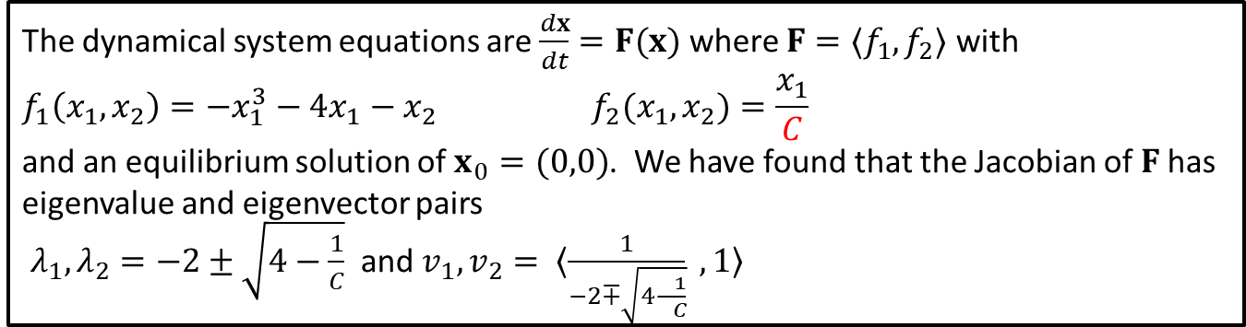
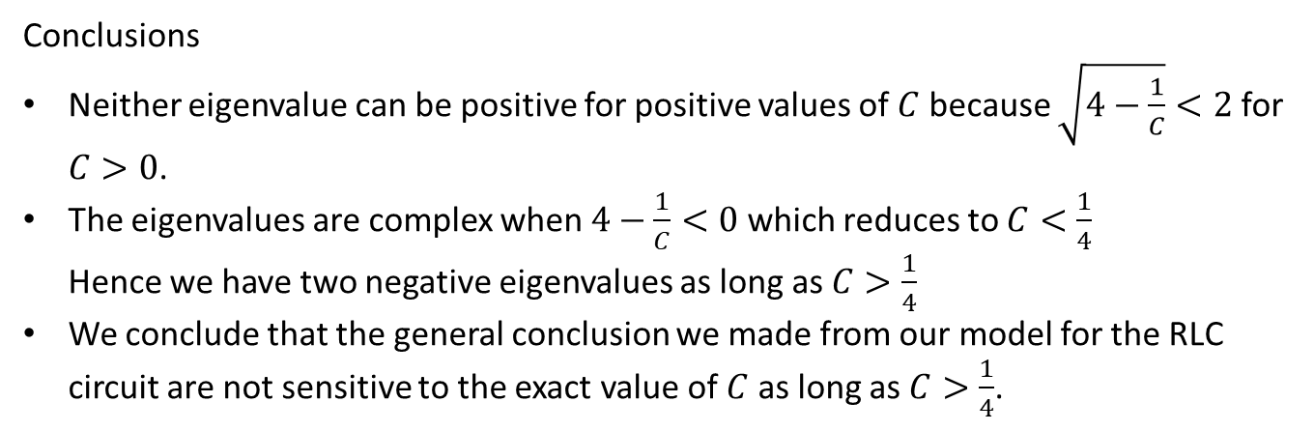
Sensitivity Analysis: Conclusion
The dynamical system equations are $\frac{dx}{dt}=F(x)$ where $F=〈f_{1},f_{2}〉$ with
$$f_{1}\left(x_{1},x_{2}\right)=−x_{1}^{3}−4x_{1}−x_{2} f_{2}(x_{1},x_{2})=\frac{x_{1}}{C}$$
and an equilibrium solution of $x_{0}=(0,0)$. We have found that the Jacobian of $F$has eigenvalue and eigenvector pairs
$λ_{1},λ_{2}=−2±\sqrt{4−\frac{1}{C}}$ and$v_{1},v_{2}= 〈\frac{1}{−2∓\sqrt{4−\frac{1}{C}}} ,1〉$
Conclusions
Neither eigenvalue can be positive for positive values of $C$ because $\sqrt{4−\frac{1}{C}}<2$ for $C>0$.
The eigenvalues are complex when $4−\frac{1}{C}<0$ which reduces to $C<\frac{1}{4}$ Hence we have two negative eigenvalues as long as $C>\frac{1}{4}$
We conclude that the general conclusion we made from our model for the RLC circuit are not sensitive to the exact value of $C$ as long as $C>\frac{1}{4}$.
Notes:
See python file section1-1pig.py

Slide 9
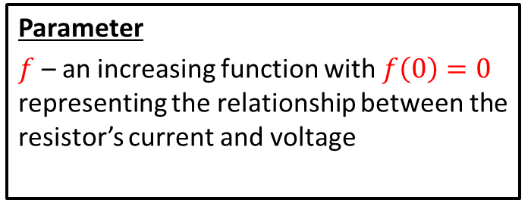
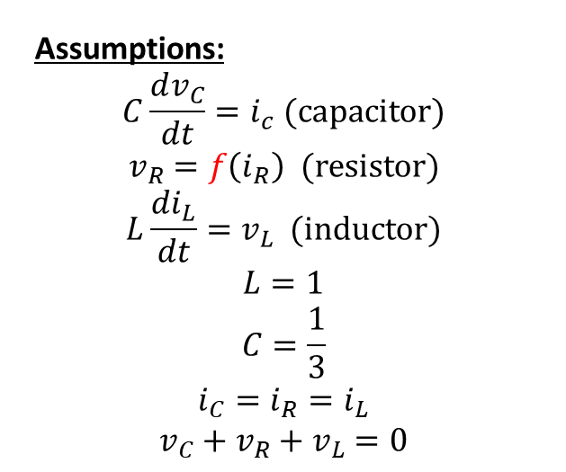
Robustness Analysis on f
Variables:
$v_{C}$ – voltage across capacitor
$i_{C}$ – current through capacitor
$v_{R}$ – voltage across resistor
$i_{R}$ – current through resistor
$v_{L}$ – voltage across inductor
$i_{L}$ – current through inductor
Objective
Determine the behavior of all six variables over time.
Assumptions:
$$C\frac{dv_{C}}{dt}=i_{c} (capacitor)$$
$$v_{R}=f\left(i_{R}\right) (resistor)$$
$$L\frac{di_{L}}{dt}=v_{L} (inductor)$$
$$L=1$$
$$C=\frac{1}{3}$$
$$i_{C}=i_{R}=i_{L}$$
$$v_{C}+v_{R}+v_{L}=0$$
Parameter
$f$ – an increasing function with $f\left(0\right)=0$ representing the relationship between the resistor’s current and voltage

Slide 10
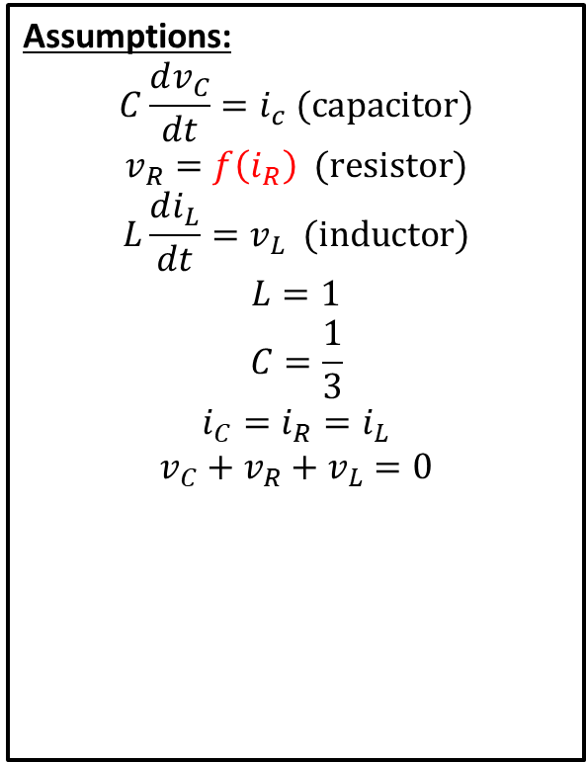
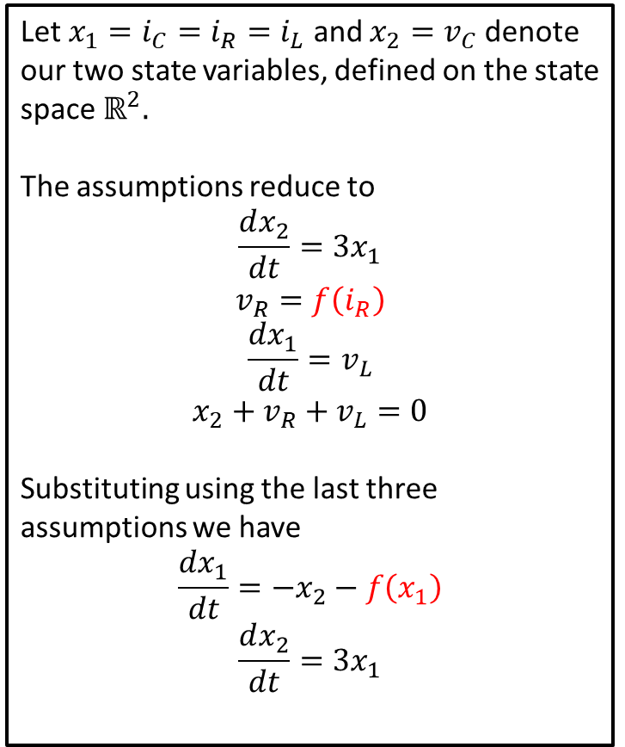
Changes to Model
Assumptions:
$$C\frac{dv_{C}}{dt}=i_{c} (capacitor)$$
$$v_{R}=f\left(i_{R}\right) (resistor)$$
$$L\frac{di_{L}}{dt}=v_{L} (inductor)$$
$$L=1$$
$$C=\frac{1}{3}$$
$$i_{C}=i_{R}=i_{L}$$
$$v_{C}+v_{R}+v_{L}=0$$
Let $x_{1}=i_{C}=i_{R}=i_{L}$ and $x_{2}=v_{C}$ denote our two state variables, defined on the state space $ℝ^{2}.$
The assumptions reduce to
$$\frac{dx_{2}}{dt}=3x_{1}$$
$$v_{R}=f\left(i_{R}\right)$$
$$\frac{dx_{1}}{dt}=v_{L}$$
$$x_{2}+v_{R}+v_{L}=0$$
Substituting using the last three assumptions we have
$$\frac{dx_{1}}{dt}=−x_{2}−f\left(x_{1}\right)$$
$$\frac{dx_{2}}{dt}=3x_{1}$$

Slide 11
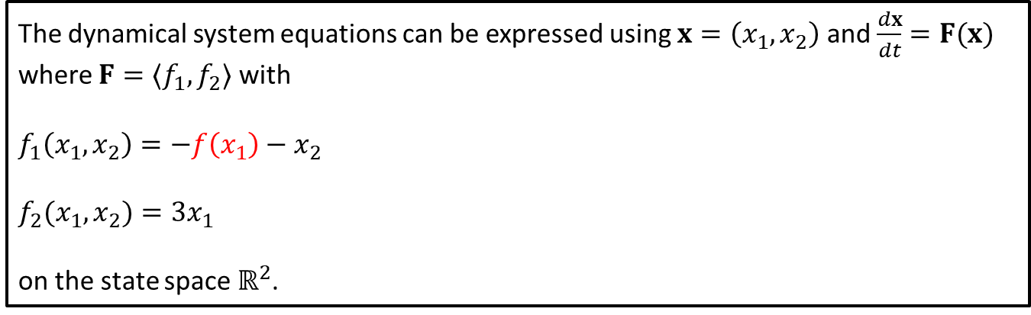

Changes to Formulation of Model
We were left with the dynamical system
$$\frac{dx_{1}}{dt}=−x_{2}−f\left(x_{1}\right)$$
$$\frac{dx_{2}}{dt}=3x_{1}$$
The dynamical system equations can be expressed using $x=\left(x_{1},x_{2}\right)$ and $\frac{dx}{dt}=F(x)$ where $F=〈f_{1},f_{2}〉$ with
$$f_{1}\left(x_{1},x_{2}\right)=−f\left(x_{1}\right)−x_{2}$$
$$f_{2}(x_{1},x_{2})=3x_{1}$$
on the state space $ℝ^{2}$.

Slide 12
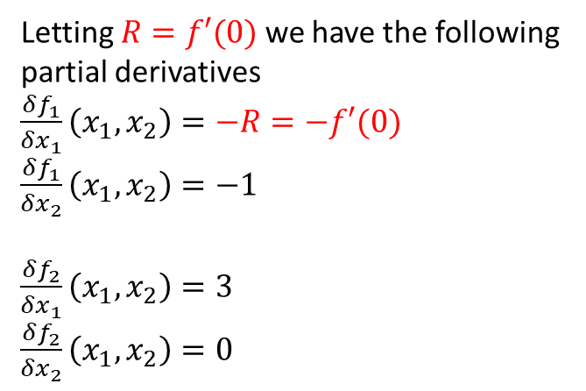
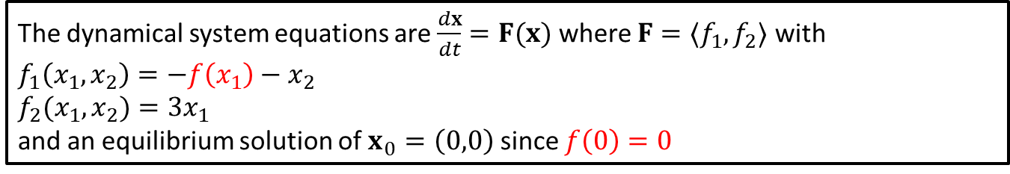
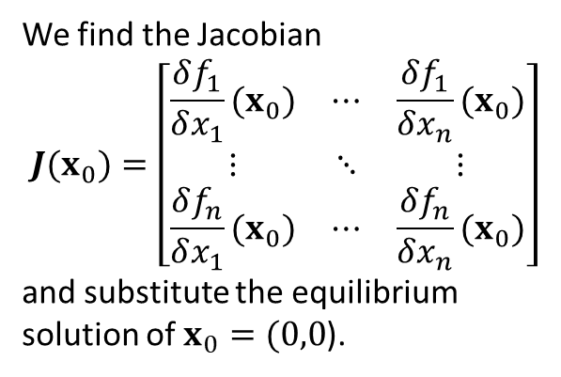
Solutions
The dynamical system equations are $\frac{dx}{dt}=F(x)$ where $F=〈f_{1},f_{2}〉$ with
$$f_{1}\left(x_{1},x_{2}\right)=−f\left(x_{1}\right)−x_{2}$$
$$f_{2}(x_{1},x_{2})=3x_{1}$$
and an equilibrium solution of $x_{0}=\left(0,0\right)$ since $f\left(0\right)=0$
We find the Jacobian
$$J(x_{0})=\left[\begin{matrix}\frac{δf_{1}}{δx_{1}}(x_{0}) & ⋯ & \frac{δf_{1}}{δx_{n}}(x_{0}) \\ ⋮ & ⋱ & ⋮ \\ \frac{δf_{n}}{δx_{1}}(x_{0}) & ⋯ & \frac{δf_{n}}{δx_{n}}(x_{0})\end{matrix}\right]$$
and substitute the equilibrium solution of $x_{0}=(0,0$).
Letting $R=f′(0)$we have the following partial derivatives
$\frac{δf_{1}}{δx_{1}}\left(x_{1}, x_{2}\right)=−R=−f′(0)$
$\frac{δf_{1}}{δx_{2}}\left(x_{1}, x_{2}\right)=−1$
$\frac{δf_{2}}{δx_{1}}\left(x_{1}, x_{2}\right)=3$
$\frac{δf_{2}}{δx_{2}}\left(x_{1}, x_{2}\right)=0$
Notes:
See python file section1-1pig.py

Slide 13
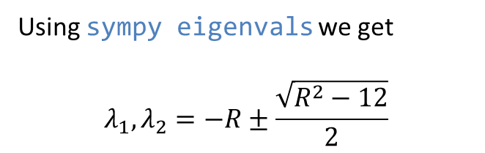
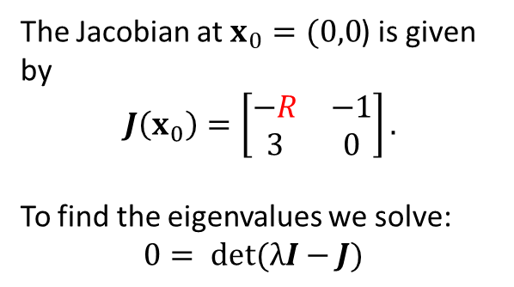
Eigenvalues and Eigenvectors
The dynamical system equations are $\frac{dx}{dt}=F(x)$ where $F=〈f_{1},f_{2}〉$ with
$$f_{1}\left(x_{1},x_{2}\right)=−f\left(x_{1}\right)−x_{2}$$
$$f_{2}(x_{1},x_{2})=3x_{1}$$
and an equilibrium solution of $x_{0}=\left(0,0\right)$ since $f\left(0\right)=0$
The Jacobian at $x_{0}=(0,0$) is given by
$$J\left(x_{0}\right)=\left[\begin{matrix}−R & −1 \\ 3 & 0\end{matrix}\right].$$
To find the eigenvalues we solve:
$$0= det(λI−J)$$
Using sympy eigenvals we get
$$λ_{1},λ_{2}=−R±\frac{\sqrt{R^{2}−12}}{2}$$
Notes:
See python file section1-1pig.py

Slide 14
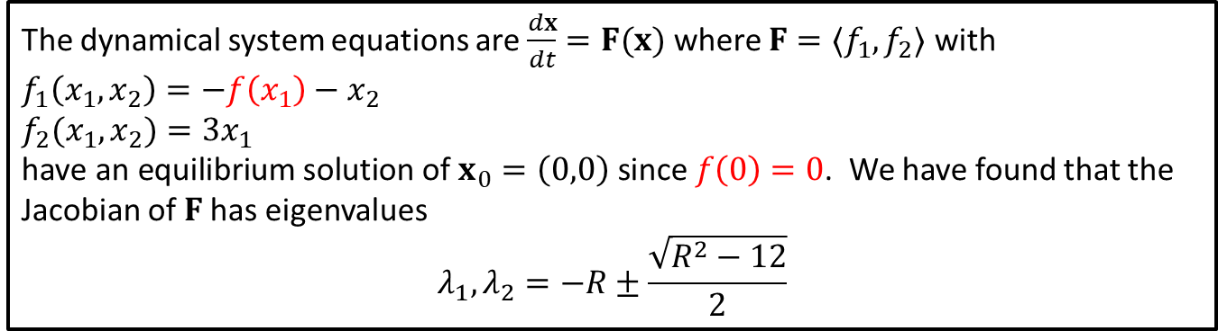
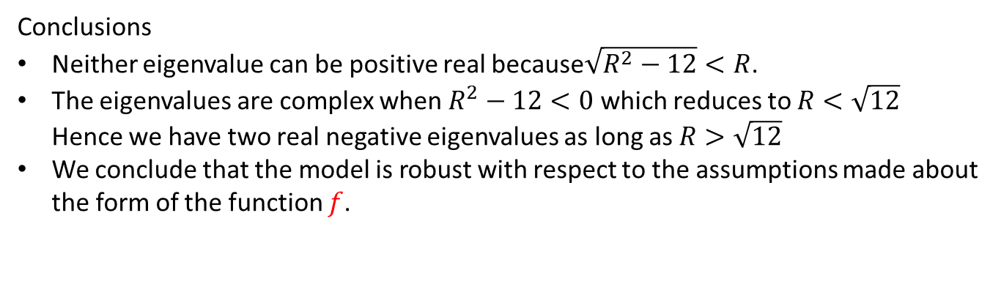
Robustness: Conclusion
The dynamical system equations are $\frac{dx}{dt}=F(x)$ where $F=〈f_{1},f_{2}〉$ with
$$f_{1}\left(x_{1},x_{2}\right)=−f\left(x_{1}\right)−x_{2}$$
$$f_{2}(x_{1},x_{2})=3x_{1}$$
$\text{have} \text{an} \text{equilibrium} \text{solution} \text{of} x_{0}=\left(0,0\right) \text{since} f\left(0\right)=0$. We have found that the Jacobian of $F$has eigenvalues
$$λ_{1},λ_{2}=−R±\frac{\sqrt{R^{2}−12}}{2}$$
Conclusions
Neither eigenvalue can be positive real because$\sqrt{R^{2}−12}<R$.
The eigenvalues are complex when $R^{2}−12<0$ which reduces to $R<\sqrt{12}$ Hence we have two real negative eigenvalues as long as $R>\sqrt{12}$
We conclude that the model is robust with respect to the assumptions made about the form of the function $f$.
Notes:
See python file section1-1pig.py

Slide 15
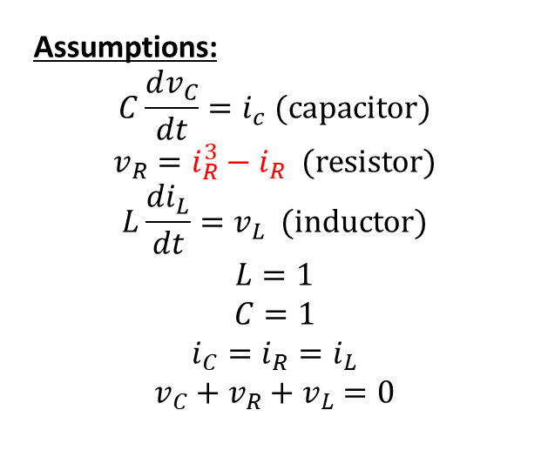
Example 5.4
Variables:
$v_{C}$ – voltage across capacitor
$i_{C}$ – current through capacitor
$v_{R}$ – voltage across resistor
$i_{R}$ – current through resistor
$v_{L}$ – voltage across inductor
$i_{L}$ – current through inductor
Objective
Determine the behavior of all six variables over time.
Assumptions:
$$C\frac{dv_{C}}{dt}=i_{c} (capacitor)$$
$$v_{R}=i_{R}^{3}−i_{R} (resistor)$$
$$L\frac{di_{L}}{dt}=v_{L} (inductor)$$
$$L=1$$
$$C=1$$
$$i_{C}=i_{R}=i_{L}$$
$$v_{C}+v_{R}+v_{L}=0$$

Slide 16
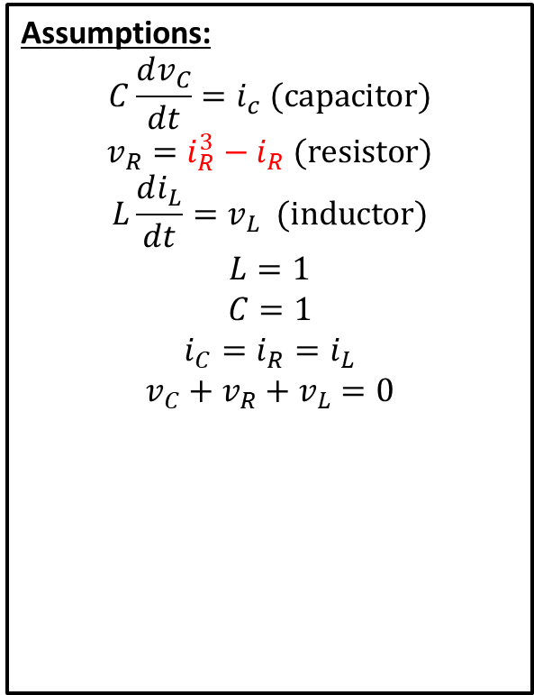
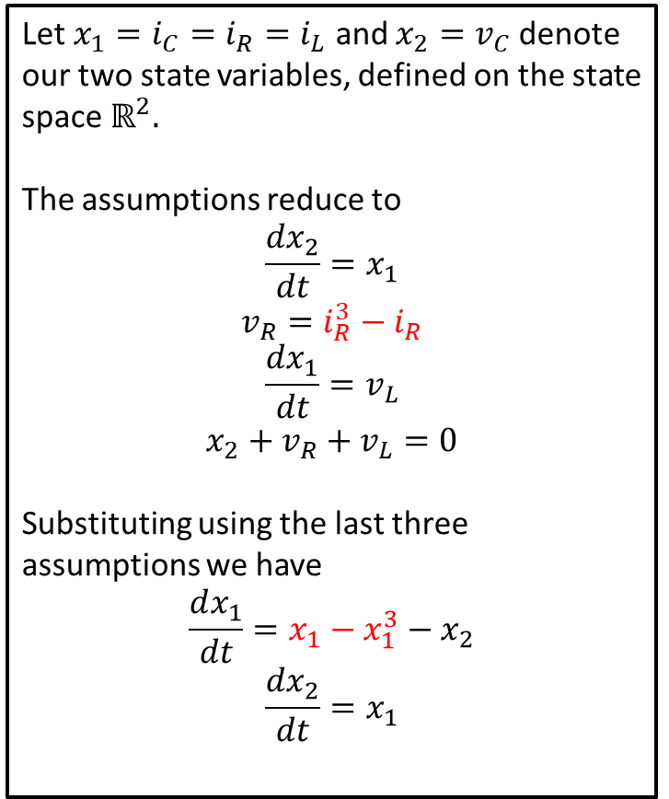
Example 5.4: Changes to Model
Assumptions:
$$C\frac{dv_{C}}{dt}=i_{c} (capacitor)$$
$$v_{R}=i_{R}^{3}−i_{R} (resistor)$$
$$L\frac{di_{L}}{dt}=v_{L} (inductor)$$
$$L=1$$
$$C=1$$
$$i_{C}=i_{R}=i_{L}$$
$$v_{C}+v_{R}+v_{L}=0$$
Let $x_{1}=i_{C}=i_{R}=i_{L}$ and $x_{2}=v_{C}$ denote our two state variables, defined on the state space $ℝ^{2}.$
The assumptions reduce to
$$\frac{dx_{2}}{dt}=x_{1}$$
$$v_{R}=i_{R}^{3}−i_{R}$$
$$\frac{dx_{1}}{dt}=v_{L}$$
$$x_{2}+v_{R}+v_{L}=0$$
Substituting using the last three assumptions we have
$$\frac{dx_{1}}{dt}=x_{1}−x_{1}^{3}−x_{2}$$
$$\frac{dx_{2}}{dt}=x_{1}$$

Slide 17
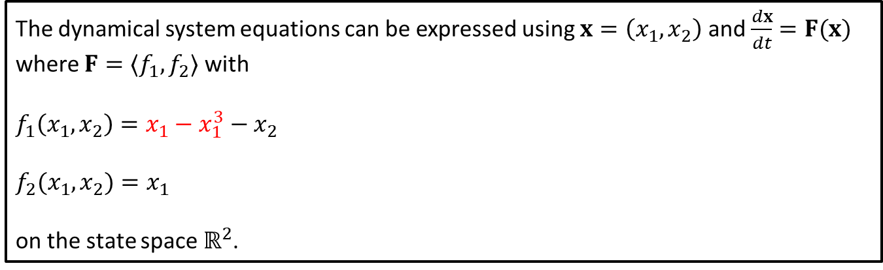

Example 5.4: Changes to Formulation of Model
We were left with the dynamical system
$$\frac{dx_{1}}{dt}=x_{1}−x_{1}^{3}−x_{2}$$
$$\frac{dx_{2}}{dt}=x_{1}$$
The dynamical system equations can be expressed using $x=\left(x_{1},x_{2}\right)$ and $\frac{dx}{dt}=F(x)$ where $F=〈f_{1},f_{2}〉$ with
$$f_{1}\left(x_{1},x_{2}\right)=x_{1}−x_{1}^{3}−x_{2}$$
$$f_{2}(x_{1},x_{2})=x_{1}$$
on the state space $ℝ^{2}$.

Slide 18
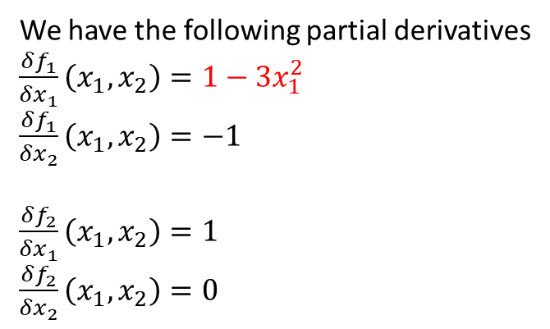
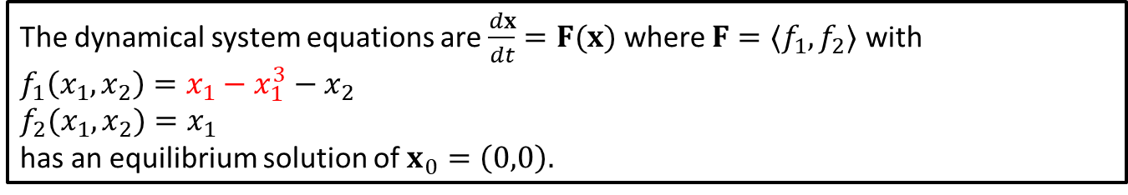
Example 5.4: Solutions
The dynamical system equations are $\frac{dx}{dt}=F(x)$ where $F=〈f_{1},f_{2}〉$ with
$$f_{1}\left(x_{1},x_{2}\right)=x_{1}−x_{1}^{3}−x_{2}$$
$$f_{2}(x_{1},x_{2})=x_{1}$$
has an equilibrium solution of $x_{0}=\left(0,0\right).$
We find the Jacobian
$$J(x_{0})=\left[\begin{matrix}\frac{δf_{1}}{δx_{1}}(x_{0}) & ⋯ & \frac{δf_{1}}{δx_{n}}(x_{0}) \\ ⋮ & ⋱ & ⋮ \\ \frac{δf_{n}}{δx_{1}}(x_{0}) & ⋯ & \frac{δf_{n}}{δx_{n}}(x_{0})\end{matrix}\right]$$
and substitute the equilibrium solution of $x_{0}=(0,0$).
We have the following partial derivatives
$\frac{δf_{1}}{δx_{1}}\left(x_{1}, x_{2}\right)=1−3x_{1}^{2}$
$\frac{δf_{1}}{δx_{2}}\left(x_{1}, x_{2}\right)=−1$
$\frac{δf_{2}}{δx_{1}}\left(x_{1}, x_{2}\right)=1$
$\frac{δf_{2}}{δx_{2}}\left(x_{1}, x_{2}\right)=0$
Notes:
See python file section1-1pig.py

Slide 19
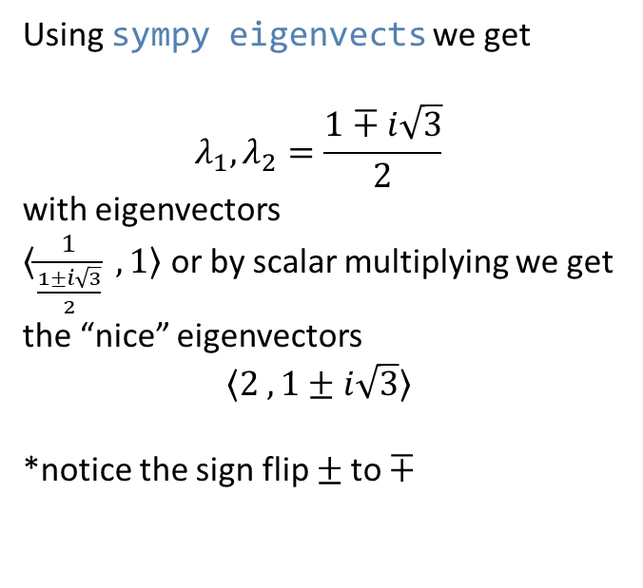

Example 5.4: Eigenvalues and Eigenvectors
The dynamical system equations are $\frac{dx}{dt}=F(x)$ where $F=〈f_{1},f_{2}〉$ with
$$f_{1}\left(x_{1},x_{2}\right)=x_{1}−x_{1}^{3}−x_{2}$$
$$f_{2}(x_{1},x_{2})=x_{1}$$
has an equilibrium solution of $x_{0}=\left(0,0\right).$
Using sympy eigenvects we get
$$λ_{1},λ_{2}=\frac{1∓i\sqrt{3}}{2}$$
with eigenvectors
$〈\frac{1}{\frac{1±i\sqrt{3}}{2}} ,1〉$ or by scalar multiplying we get the “nice” eigenvectors
$$〈2 ,1±i\sqrt{3}〉$$
*notice the sign flip $±$to $∓$
The Jacobian at $x_{0}=(0,0$) is given by
$$J\left(x_{0}\right)=\left[\begin{matrix}1 & −1 \\ 1 & 0\end{matrix}\right].$$
To find the eigenvalues we solve:
$$0= det(λI−J)$$
Notes:
See python file section1-1pig.py

Slide 20
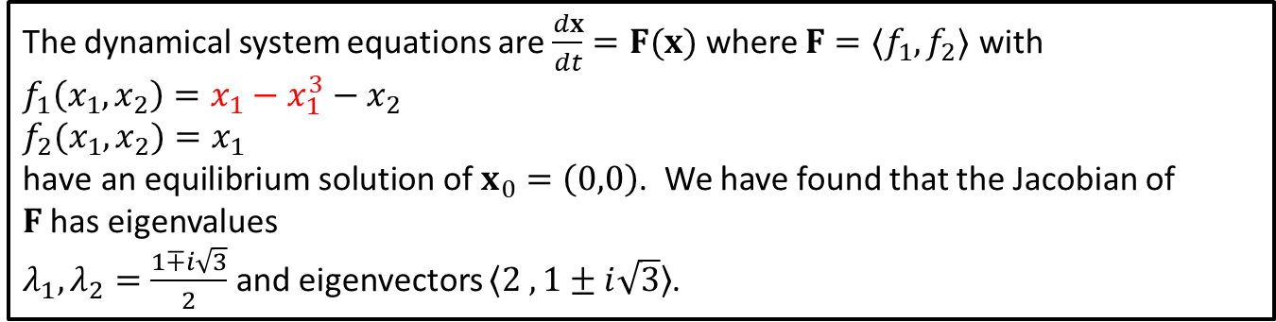
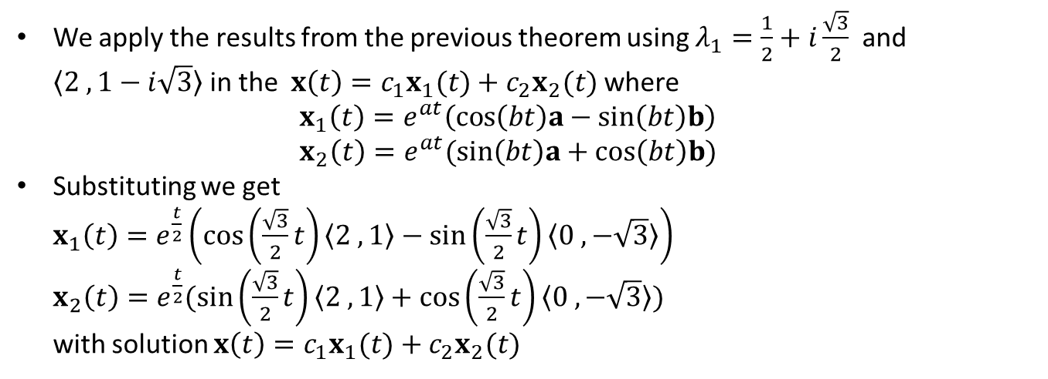
Example 5.4: Conclusion
The dynamical system equations are $\frac{dx}{dt}=F(x)$ where $F=〈f_{1},f_{2}〉$ with
$$f_{1}\left(x_{1},x_{2}\right)=x_{1}−x_{1}^{3}−x_{2}$$
$$f_{2}(x_{1},x_{2})=x_{1}$$
$\text{have} \text{an} \text{equilibrium} \text{solution} \text{of} x_{0}=\left(0,0\right)$. We have found that the Jacobian of $F$has eigenvalues
$λ_{1},λ_{2}=\frac{1∓i\sqrt{3}}{2}$ and eigenvectors $〈2 ,1±i\sqrt{3}〉$.
We apply the results from the previous theorem using $λ_{1}=\frac{1}{2}+i\frac{\sqrt{3}}{2}$ and $〈2 ,1−i\sqrt{3}〉$ in the $x\left(t\right)=c_{1}x_{1}(t)+c_{2}x_{2}(t)$ where $x_{1}\left(t\right)=e^{at}\left(cos\left(bt\right)a−sin\left(bt\right)b\right)$ $x_{2}\left(t\right)=e^{at}(sin\left(bt\right)a+cos\left(bt\right)b)$
Substituting we get $x_{1}\left(t\right)=e^{\frac{t}{2}}\left(cos\left(\frac{\sqrt{3}}{2}t\right)〈2 ,1〉−sin\left(\frac{\sqrt{3}}{2}t\right)〈0 ,−\sqrt{3}〉\right)$ $x_{2}\left(t\right)=e^{\frac{t}{2}}(sin\left(\frac{\sqrt{3}}{2}t\right)〈2 ,1〉+cos\left(\frac{\sqrt{3}}{2}t\right)〈0 ,−\sqrt{3}〉)$ with solution $x\left(t\right)=c_{1}x_{1}(t)+c_{2}x_{2}(t)$
Notes:
See python file section1-1pig.py

Slide 21
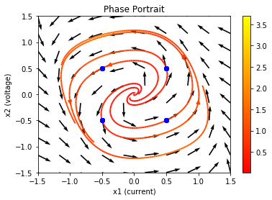
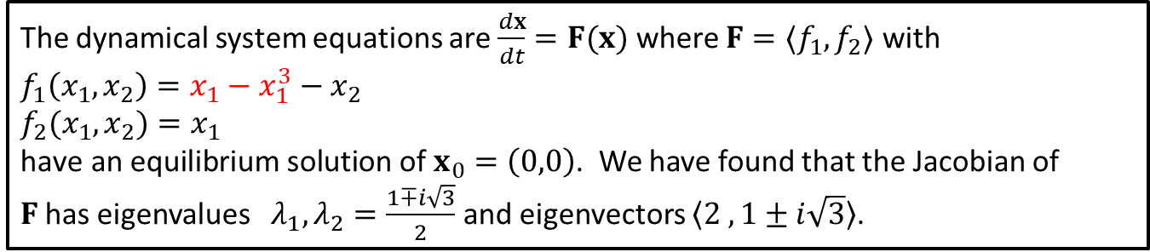
Example 5.4: Conclusion
The dynamical system equations are $\frac{dx}{dt}=F(x)$ where $F=〈f_{1},f_{2}〉$ with
$$f_{1}\left(x_{1},x_{2}\right)=x_{1}−x_{1}^{3}−x_{2}$$
$$f_{2}(x_{1},x_{2})=x_{1}$$
$\text{have} \text{an} \text{equilibrium} \text{solution} \text{of} x_{0}=\left(0,0\right)$. We have found that the Jacobian of $F$has eigenvalues $λ_{1},λ_{2}=\frac{1∓i\sqrt{3}}{2}$ and eigenvectors $〈2 ,1±i\sqrt{3}〉$.
Creating the phase portrait for this situation we examine solutions near the equilibrium of (0,0).
Here solutions spiral outward counterclockwise from the equilibrium.
Notes:
See python file section1-1pig.py

